Slide 1

Clustering
Instructor: Jesse Davis
Slides from: Colin Dewey, Pedro Domingos, Ray Mooney, David Page, Sofus Macskassy, Dan Weld

Slide 2
Outline
Unsupervised learning, clustering intro
Hierarchical clustering
Partitional clustering
Model-based clustering
Applications

Slide 3
Unsupervised Learning
Supervised learning:
Data are set of pairs <x,y>, where y=f(x)
Goal: Approximate f
Unsupervised learning: the data is just x!
Goal: Find structure in the data
Challenge: Ground truth is often missing (no clear error function, like in supervised learning)

Slide 4
Uses of Unsupervised Learning
Visualization of the data
Data compression
Density estimation: what distribution generated the data?
Preprocessing step for supervised learning
Partition data
Novelty detection

Slide 5
Unsupervised Learning: Clustering
In many problems there are no class labels
Humans: How do we form categories of objects?
Humans are good at creating groups/categories/clusters from data
Image analysis finding groups in data is very useful
e.g., can find pixels with similar intensities
e.g., can find images that are similar -> can automatically find classes/clusters of images

Slide 6
What is Clustering
Cluster: a collection of data objects
Similar to one another within the same cluster
Dissimilar to the objects in other clusters
Cluster analysis: Grouping objects into clusters
Clustering is unsupervised classification
Clusterings are usually not right or wrong
Different clusterings can reveal different things about the data
More direct measure of goodness if it is a first step towards supervised learning, or data compression

Slide 7
How is Clustering Used
Clustering is grouping similar objects together
To establish prototypes or detect outliers
To simplify data for further analysis/learning
To visualize data
As a stand-alone tool to get insight into data distribution
As a preprocessing step for other algorithms

Slide 8
Example: Two Clusters
Feature 2
Feature 1

Slide 9

Example: Gene Expression
(Green = up-regulated, Red = down-regulated)
Genes
Experiments (Samples)

Slide 10
Clustering Applications
Marketing: Help marketers discover distinct groups in their customer bases, and then use this knowledge to develop targeted marketing programs
Land use: Identification of areas of similar land use in an earth observation database
Insurance: Identify groups of motor insurance policy holders with a high average claim cost
Urban planning: Identify groups of houses according to their house type, value, and geographical location
Seismology: Observed earth quake epicenters should
be clustered along continent faults

Slide 11
What Is a Good Clustering?
A good clustering method will produce clusters with
High intra-class similarity
Low inter-class similarity
Precise definition of clustering quality is difficult
Application-dependent
Ultimately subjective

Slide 12
Requirements for Clustering in
Data Mining
Scalability
Ability to deal with different types of attributes
Discovery of clusters with arbitrary shape
Minimal domain knowledge required to determine input parameters
Ability to deal with noise and outliers
Insensitivity to order of input records
Robustness with respect to high dimensionality
Incorporation of user-specified constraints
Interpretability and usability

Slide 13
The Clustering Problem
Let x = (x₁, x₂,…,x_{d}) be a d-dimensional feature vector
Let D be a set of x vectors,
D = { x₁, x₂,…, x_{N} }
Given data D, group the N vectors into K groups such that the grouping is “optimal”

Slide 14
Basic Concept: Distances/Similarities
Clustering methods use a distance (similarity) measure to assess the distance between
a pair of instances
a cluster and an instance
a pair of clusters
Given a distance value, can convert it into a similarity value: sim(i,j) = 1/[1+dist(i,j)]
Not always straightforward to go the other way
We’ll describe our algorithms in terms of distances

Slide 15
Distances Between Instances
Same we used for IBL (e.g., Lp norm)
Euclidean distance (p = 2):
d(i, j) = (| x − x
|² +| x − x |² +...+| x − x |² )
i1 j1 i2 j2 ip jp
Properties of a metric d(i,j):
d(i,j) ≥ 0
d(i,i) = 0
d(i,j) = d(j,i)
d(i,j) ≤ d(i,k) + d(k,j)

Slide 16

Basic Concept: Clusters Structure
Hierarchical
Flat

Slide 17
Basic Concept: Cluster Assignment
Hard clustering:
Each item in only one cluster
Soft clustering:
Each item has a probability of membership in each cluster
Disjunctive / overlapping clustering:
An item can be in more than one cluster

Slide 18
Major Clustering Approaches
Hierarchical: Create a hierarchical decomposition of the set of objects using some criterion
Partitioning: Construct various partitions and then evaluate them by some criterion
Model-based: Hypothesize a model for each cluster and find best fit of models to data
Density-based: Guided by connectivity and density functions

Slide 19
Outline
Unsupervised learning, clustering intro
Hierarchical clustering
Partitional clustering
Model-based clustering
Applications

Slide 20
Hierarchical Clustering
Can do top-down (divisive) or bottom-up (agglomerative)
In either case, we maintain a matrix of distance (or similarity) scores for all pairs of
Instances
Clusters (formed so far)
Instances and clusters

Slide 21
Hierarchical Clustering: Dendogram
Bar height indicates degree of difference within cluster
Distance scale
Leaves represent instances

Slide 22
Bottom-Up Hierarchical Clustering
Given: instances x₁,…,x_{n} For i = 1 to n, c_{i} = {x_{i}} C = {c₁,…,c_{n}}
j = n
While |C| > 1 j = j+1
(c_{a},c_{b}) = argmin dist(c_{u},c_{v}) c_{j} = c_{a} U c_{b}
add node to tree joining a and b C = (C – {c_{a},c_{b}}) U c_{j}
Return tree with root node j

Slide 23
Bottom-Up Example

Slide 24
Distance Between Two Clusters
The distance between two clusters can be determined in several ways
Single link: distance of two most similar instances: dist(c_{u}, c_{v}) = min{dist(a, b) | a∈c_{u}, b∈c_{v}}
Complete link: distance of two least similar instances: dist(c_{u}, c_{v}) = max{dist(a, b) | a∈c_{u}, b∈c_{v}}
Average link: average distance between instances: dist(c_{u}, c_{v}) = avg{dist(a, b) | a∈c_{u}, b∈c_{v}}

Slide 25
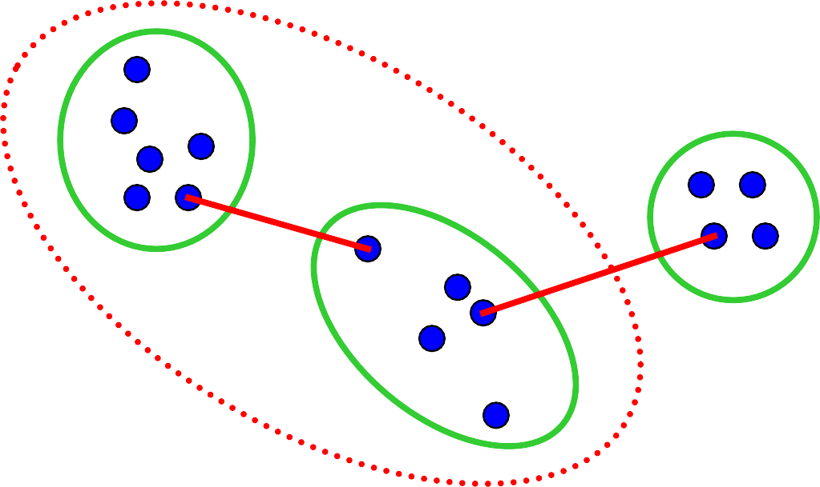
Single Link
Cluster similarity = similarity of two most similar members

Slide 26

Complete Link
Cluster similarity = similarity of two least similar members

Slide 27
Average Link
Cluster similarity = average similarity of all pairs
Note: Picture doesn’t show all connections

Slide 28
Efficient Distance Updates
If we merged and c_{u} and c_{v} into c_{j}, we can determine distance to each other cluster:
Single link:
dist(c_{j}, c_{k}) = min{dist(c_{u}, c_{k}) , dist(c_{v}, c_{k})}
Complete link:
dist(c_{j}, c_{k}) = max{dist(c_{u}, c_{k}) , dist(c_{v}, c_{k})}
■
^{Average link:}|c | * dist(c , c ) + |c | * dist(c , c )
dist(c_{j}, c_{k}) =
u u k v v k
|c_{u}| + |c_{v}|

Slide 29
Single Link
Chaining:

Slide 30
Single Link
Chaining:

Slide 31
Single Link
Chaining:

Slide 32
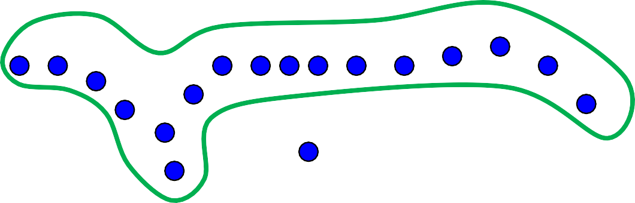
Single Link
Chaining:
Bottom line:
Simple, fast
Often low quality

Slide 33
Complete Link
Worst case O(n³)
Fast algorithm: Requires O(n²) space
No chaining
Bottom line:
Typically much faster than O(n³)
Often good quality

Slide 34
Divisive or Top-Down Clustering
Initialize: All items one cluster Iterate:
select a cluster c_{j} (least coherent)
divide c_{j} into two clusters
Halt: When have required # of clusters
Note: Step 2 requires another clustering algorithm!

Slide 35
Top-Down Example

Slide 36
Outline
Unsupervised learning, clustering intro
Hierarchical clustering
Partitional clustering
Model-based clustering
Applications
49

Slide 37
Partitioning Algorithms
Partitioning method: Construct a partition of a database
D of n objects into a set of k clusters
Given a k, find a partition of k clusters that optimizes the chosen partitioning criterion
Global optimal: exhaustively enumerate all partitions
Heuristic methods: k-means, k-medoids algorithms
k-means (MacQueen, 1967): Each cluster is
represented by the center of the cluster
k-medoids or PAM (Partition around medoids) (Kaufman & Rousseeuw, 1987): Each cluster is represented by one of the objects in the cluster
50

Slide 38
Partitional Clusterings
Divide instances into disjoint clusters
Flat vs. tree structure
Key issues:
How many clusters should there be?
How should clusters be represented?

Slide 39
Partitional Clustering from a Hierarchical Clustering
Can generate a partitional clustering from a hierarchical clustering by “cutting” the tree at some level
Cutting here gives 2 clusters
Cutting here gives 4 clusters

Slide 40
k-Means Clustering
A commonly-used clustering algorithm
Easy to implement
Quick to run
Assumes
Objects are n-dimensional vectors
Distance/similarity measure between these instances
Goal: Partition the data in K disjoint subsets
Ideally: Partition reflects the structure of the data

Slide 41
k-Means with k=2
Pick seeds Reassign clusters Compute centroids Reassign clusters Compute centroids Reassign clusters
Converged!
x
x _{x}
x
58

Slide 42
K-Means Summary
Strengths
Efficient: O(Ikdn)
Straightforward to implement
Finds local optimum, can use restarts more advanced search to find better solution
Weaknesses
Must be able to define mean
Need to provide k
Susceptible to noise and outliers
Cannot represent non-convex clusters
78

Slide 43
Any questions?
78

